Slide 1

HMI Screen Validation Tool

Slide 2
Screenshot Validation Process
Screen dump
Screenshots preparation by GRET tool for - Nissan ST2.1 - Nissan ST3.1 - MMC ST3.1 - P-IVI - PIVI ST3.1 (Nissan & Infinity).
Screen validation
Validate screenshots manually. Issue detection and verification (Truncation, missing title, text overlap, not translated issue…).
Report presentation
Reporting in weekly Bosch Management Meeting (HMI) based on the plan (with Nissan).
Ticket creation
Create and update tickets status for detected issues.
1

Slide 3
GRET (GUI Robustness Engineering Tool) introduction
A tool that can taking screenshots automatically of all HMI components (MEDIA, PHONE, NAVIGATION…) in car multimedia system.
In other words, this tool can support to take these screenshots in various languages depending on specific regions (US, EUR, Japan, ASIA…).
After taking screenshots, the team will do screen validation to detect what issues happen on these screens (Ex: Text is truncated, button position is deviated, title is not translated, text is overlapping) and then report the status of detected issues to the customer (Nissan).

Slide 4
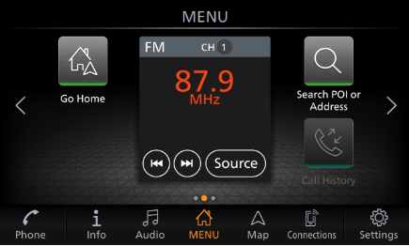
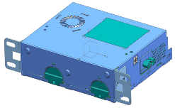
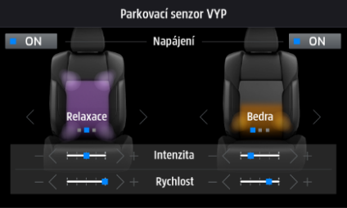

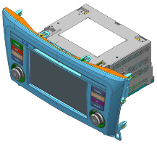
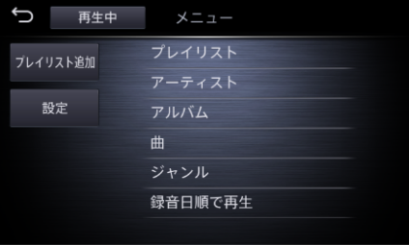
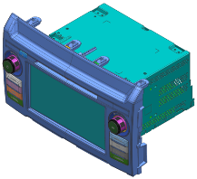
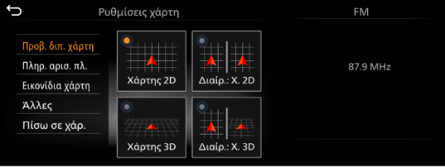
ScreenDump Process
Physical Connect
ScreenDump
Computer
Gen3/Gen4
Head Unit
Screenshots of Head Unit
3

Slide 5
Problem
Gen3 / Gen4
Head Unit
ScreenDump
Android
Head Unit
Validation
4

Slide 6
Solution
Gen3 / Gen4
Head Unit
ScreenDump
Android
Head Unit
Validation
Android ScreenDump
5

Slide 7
Tool Structure
PC
+ Linux
+ Windows
Android
ScreenDump
Tool
ADB
Android-Debug-Bridge
Command
Android
Target
6

Slide 8
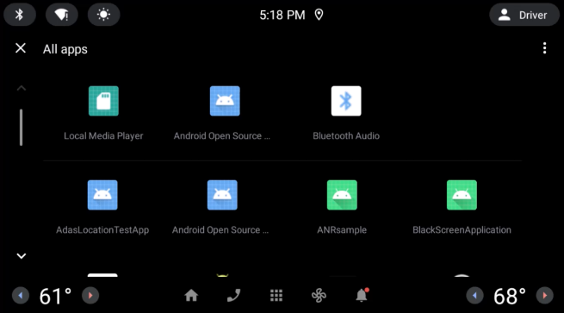
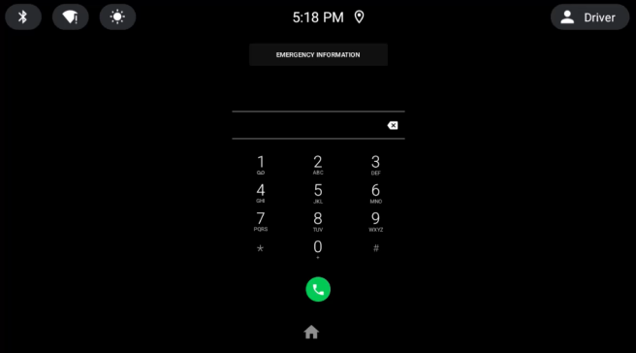
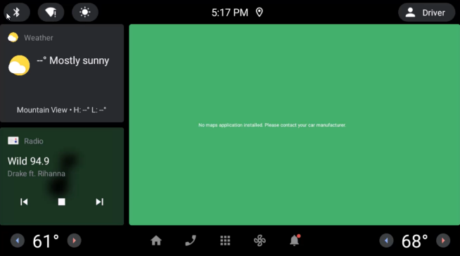
Screenshots of Android Head Unit
Android ScreenDump Process
Android
ScreenDump
Tool
Designated Activity & Actions
7

Slide 9

8

Slide 10
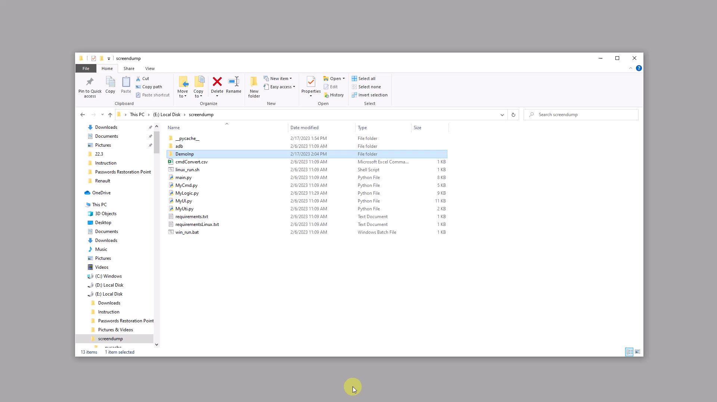
8

Slide 11
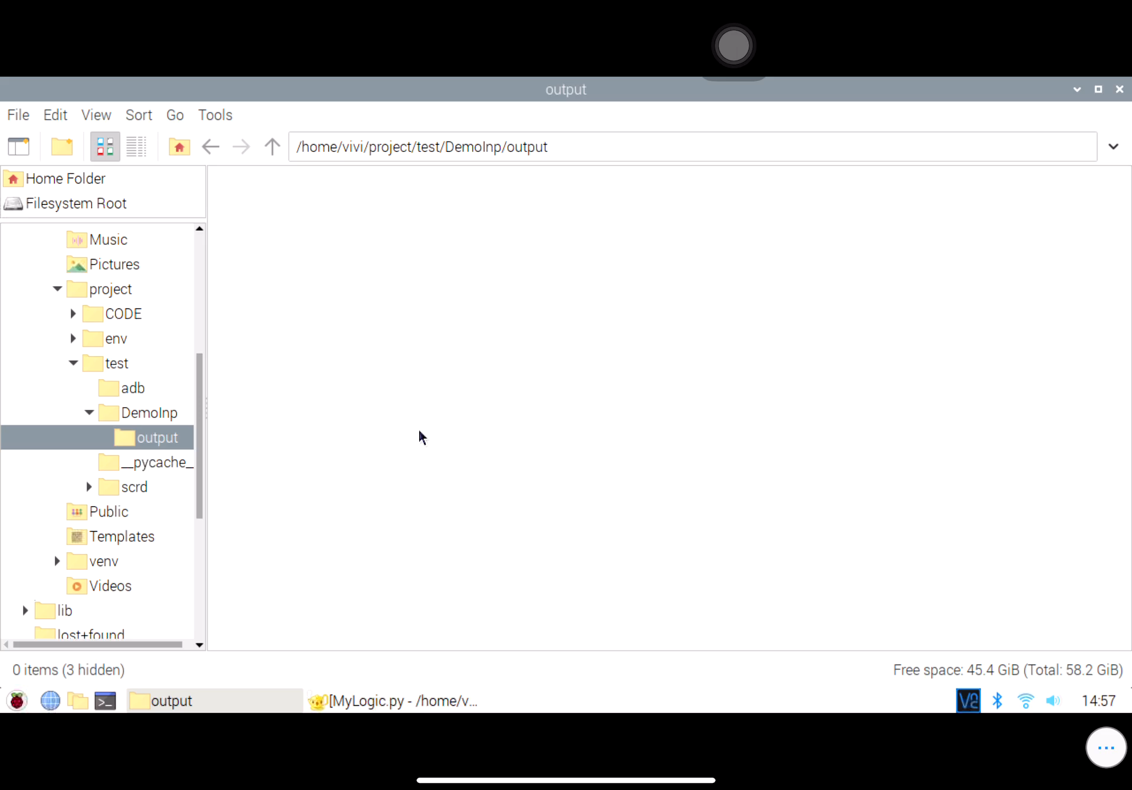
8

Slide 12
Thank you

